Slide 1

Welcome to
Back to School Night
Physics
Mrs. Bilotta

Slide 2
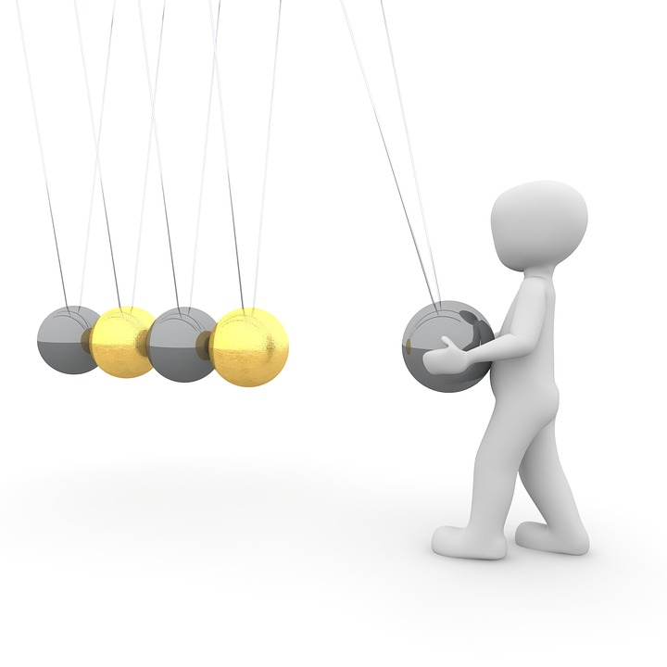
Physics
Mrs. Bilotta

Slide 3
About Me
I have been teaching science for over 20 years.
I am married and have 4 children, all boys.
My hobbies include crafts, halloween costumes, fishing and camping.

Slide 4
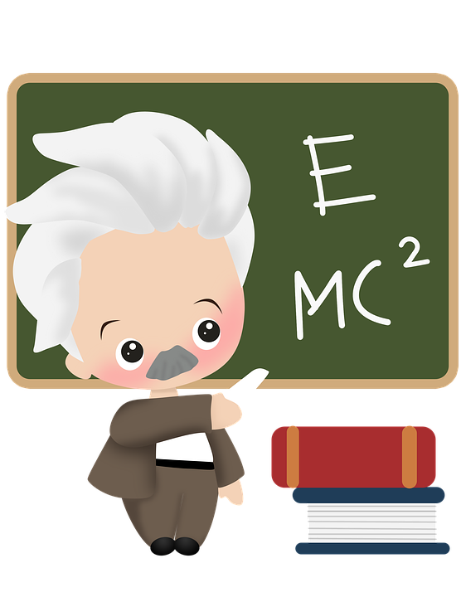
Course Outline
Linear Motion Vectors Projectiles Forces Momentum Energy Rotational Mechanics/Dynamics Waves Sound Light Electricity & Magnetism

Slide 5
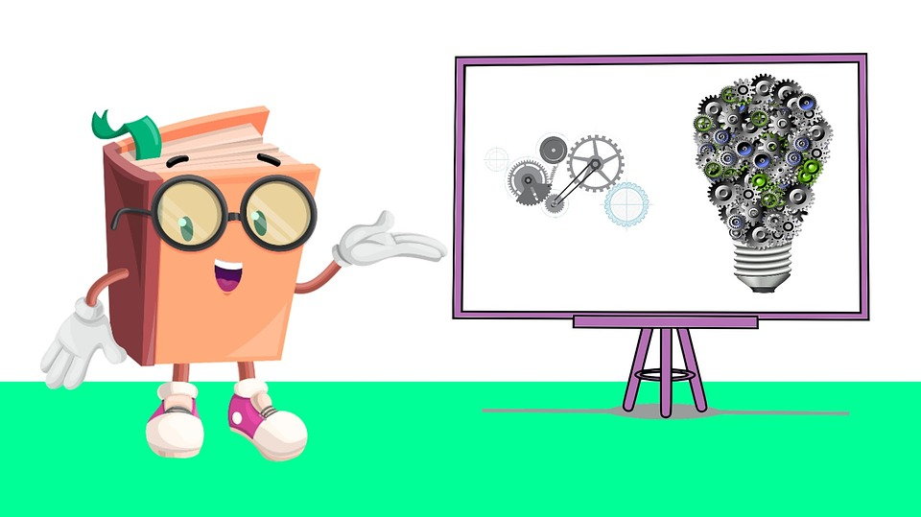
Instruction Includes:
Powerpoint presentations
Demonstrations
Labs
Discussions
Practice
Virtual Cooperative
learning activities

Slide 6
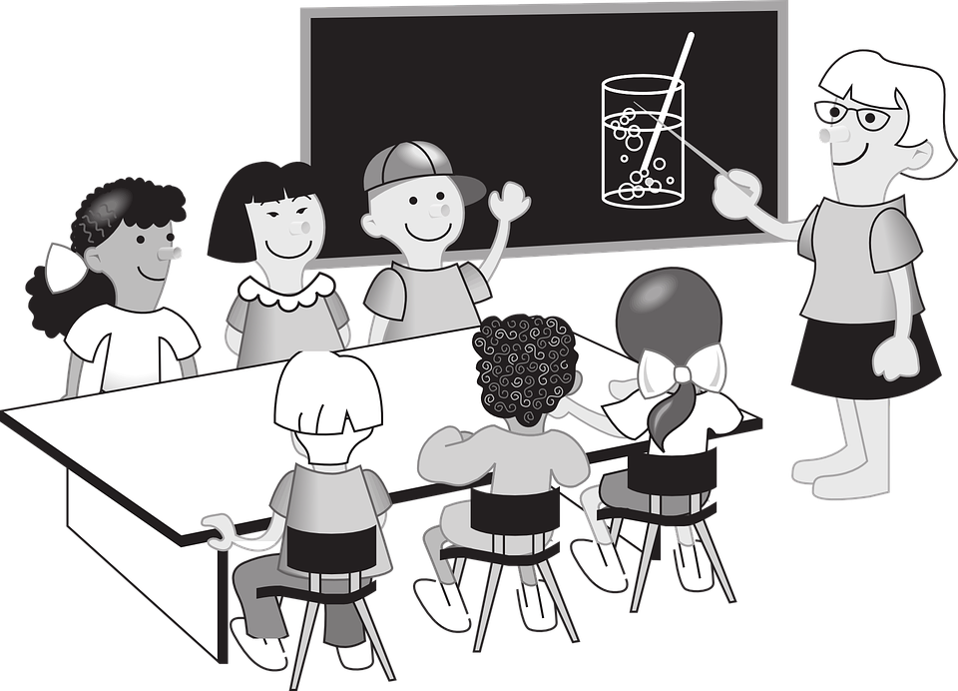
Classroom Policies

Slide 7

Homework
Homework is due on time
Late work will not be accepted
Homework assignments can be found on your child’s google classroom account
https://classroom.google.com/u/0/h

Slide 8

Classroom Rules
Follow all directions the first time
Enter class quietly on time and
  prepared to work
Only one person talking at a time in any group setting
Stay in your seat unless you have
permission to get up
No eating, drinking, or gum chewing
Masks must be worn at all times

Slide 9
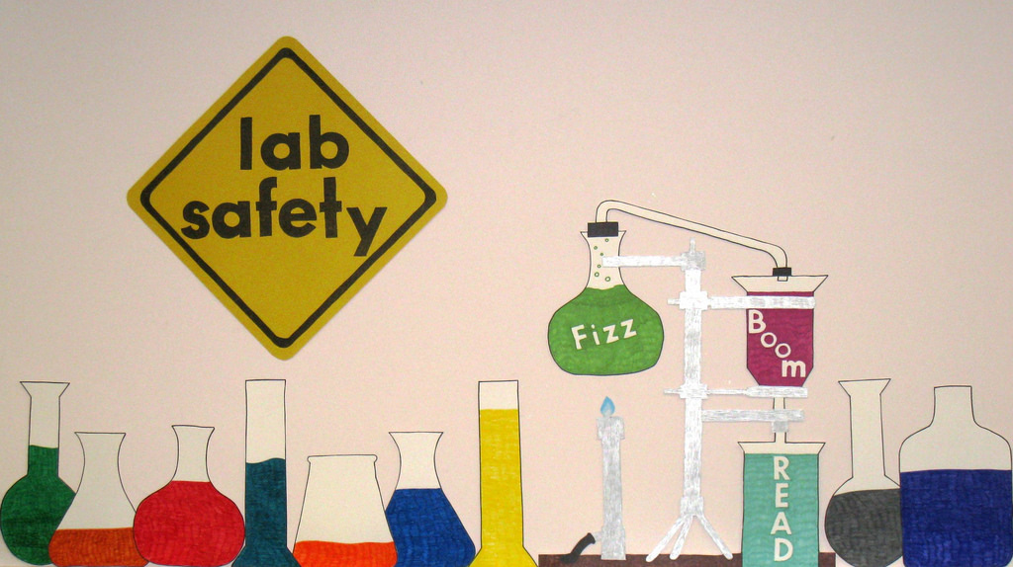
LAB SAFETY

Slide 10

Our Textbook
Website:
http://www.pearsonmylabandmastering.com/northamerica/masteringphysics/
Each student has their own user name

Slide 11

Grading Percentages
55% Assessment :
  Tests
  Quizzes
20% Homework:
  Homework Assignments
  Completing Lab Write-ups
25% Participation:
  Class Participation
  Lab Participation

Slide 12

Grades
Grades are available on genesis usually within days of completing work.

Slide 13

Help
Students should reach out whenever they need help.

Slide 14
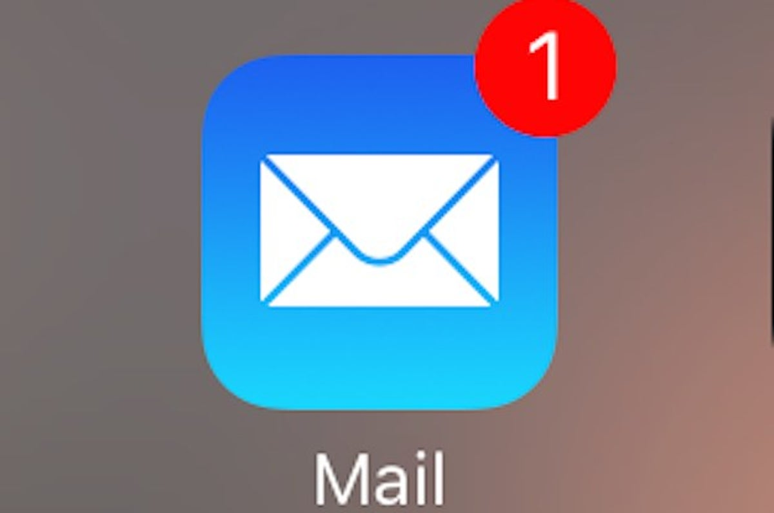
How to Contact Me?
Email:
  kmbilotta@jacksonsd.org
Phone :
  (732) 833-4600
  Call the school and leave a message
Either way, I will get back to you as soon as possible.

Slide 15
My School Wires class page
http://www.jacksonsd.org/Domain/601

Slide 16

??????? Questions ???????

